Slide 1
The Extreme-scale Scientific Software Stack (E4S) for Collaborative Open Source Software
Michael A. Heroux, Sandia National Laboratories
Director of Software Technology, US Exascale Computing Project
The 2nd R-CCS International Symposium
February 18, 2020

Slide 2
ECP Context for E4S

Slide 3
ECP Software Technology (ST) is one of three focus areas
Performant mission and science applications @ scale
Aggressive RD&D Project
Mission apps & integrated S/W stack
Deployment to DOE HPC Facilities
Hardware tech advances
Application
Development (AD)
Software Technology (ST)
Hardware and Integration (HI)
Develop and enhance the predictive capability of applications critical to the DOE
24 applications including national security, to energy, earth systems, economic security, materials, and data
Deliver expanded and vertically integrated software stack to achieve full potential of exascale computing
70 unique software products spanning programming models and run times, math libraries, data and visualization
Integrated delivery of ECP products on targeted systems at leading DOE HPC facilities
6 US HPC vendors focused on exascale node and system design; application integration and software deployment to facilities

Slide 4
ECP ST has six technical areas
Programming Models & Runtimes
Enhance and get ready for exascale the widely used MPI and OpenMP programming models (hybrid programming models, deep memory copies)
Development of performance portability tools (e.g. Kokkos and Raja)
Support alternate models for potential benefits and risk mitigation: PGAS (UPC++/GASNet) ,task-based models (Legion, PaRSEC)
Libraries for deep memory hierarchy and power management
Development Tools
Continued, multifaceted capabilities in portable, open-source LLVM compiler ecosystem to support expected ECP architectures, including support for F18
Performance analysis tools that accommodate new architectures, programming models, e.g., PAPI, Tau
Math Libraries
Linear algebra, iterative linear solvers, direct linear solvers, integrators and nonlinear solvers, optimization, FFTs, etc
Performance on new node architectures; extreme strong scalability
Advanced algorithms for multi-physics, multiscale simulation and outer-loop analysis
Increasing quality, interoperability, complementarity of math libraries
Data and Visualization
I/O via the HDF5 API
Insightful, memory-efficient in-situ visualization and analysis – Data reduction via scientific data compression
Checkpoint restart
Software Ecosystem
Develop features in Spack necessary to support all ST products in E4S, and the AD projects that adopt it
Development of Spack stacks for reproducible turnkey deployment of large collections of software
Regular E4S releases of the ST software stack and SDKs with regular integration of new ST products
Optimization and interoperability of containers on HPC systems
NNSA ST
Open source NNSA Software projects
Projects that have both mission role and open science role
Cover most ST technology areas
Subject to the same planning, reporting and review processes
Major technical areas: New programming abstractions, math libraries, data and viz libraries
Notes:
Open MP
Identified that one of the most important gaps in OpenMP is how to program the different memories available in the node and how to map to/from complex data structures between them that require deep copy
Gathered application use cases from E3SM, QMCPack, XGC, LSMS3, LAMMPS, GENESIS, etc. Used this information to drive the memory management API, declare mappers and manual deep copy functionality in OpenMP 5.0.
Developed test cases to implement manual deep copy, declare mappers and the new memory management API in OpenMP 5.0.
A SOLLVE software release was made publicly available on GitHub at https://github.com/SOLLVE/sollve. Enhancements include: 1) better performance for OpenMP nested parallel regions using BOLT lightweight threading, 2) improvements that facilitate optimization of OpenMP outlined functions, 3) initial support for OpenMP 5.0 declare mapper to enable accelerator deep copy, 4) pragmas to succinctly direct advanced loop transformations, and 5) an OpenMP offloading validation & verification suite, that allows users and vendors to validate OpenMP implementations.
Exa-PAPI builds on the latest PAPI project and we are extending it with:
Effort 1: Performance counter monitoring capabilities for new and advanced ECP hardware, and software technologies.
Effort 2: Fine-grained power management support.
Effort 3: Functionality for performance counter analysis at "task granularity" for task-based runtime systems.
Effort 4: "Software-defined Events" that originate from the ECP software stack and are currently treated as black boxes (i.e., communication libraries, math libraries, task-based runtime systems, etc.)
Co-Design of a new standard API for SDEs with libraries and runtime communities. (FY18)
Implement infrastructure for SDE support in Exa-PAPI. (FY18 + FY19)
STRUMPACK
Better OpenMP support in HSS compression, HSS factorization and HSS matvec.
Use OpenMP tasking parallelism, e.g. taskloop
Improved threading in element extraction, ULV factorization
Threading improvements in sparse-matrix randomized sampling.
Results:
Dense matrix HSS compression is up to 4.7x faster on 8 nodes (256 cores) of Cori-Haswell and 2.4x faster on Cori-NKL.
The HSS embedded sparse factorization, is up to 2.2x faster on 8 KNL nodes.
By fixing a memory bottleneck, we can now compress much larger HSS matrices.
zfp: compressed format for error-controlled reduction in I/O and storage
In-memory compressed storage of tables & viz data with prescribed footprint
Capacity limited apps & in situ, in transit, and post hoc viz are enabled by compressed arrays
Bandwidth reduction for CPU ⟺ GPU, node-to-node communication, I/O
Error-bounded data reduction for checkpoint & viz file storage
Massively data-parallel (de)compression via block decomposition
zfp is ideally positioned to exploit manycore architectures
More accurate representation than IEEE
Same accuracy at half the storage or less
Orders of magnitude more accurate using same storage
Team members developed popular, open source tools (ParaView, VisIt) based on the Visualization ToolKit library (VTK)
Widespread usage in DOE and >1 million downloads worldwide
Hundreds of person years of effort
Major visualization and analysis problems for exascale:
Many-core architectures
I/O limitations will require data reduction/ in situ processing
Artifacts created will require new methods of analysis and visualization

Slide 5
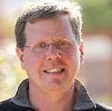
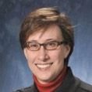
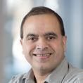

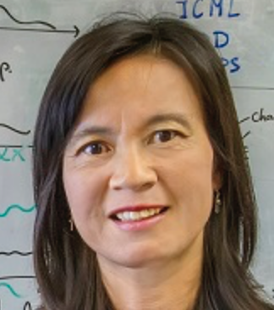
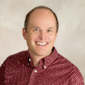
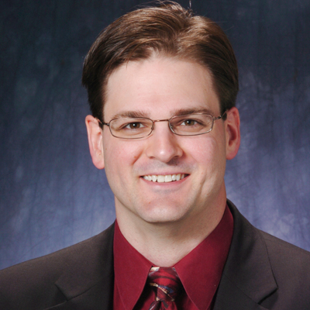

ECP Software Technology Leadership Team
Mike Heroux, Software Technology Director
Mike has been involved in scientific software R&D for 30 years. His first 10 were at Cray in the LIBSCI and scalable apps groups. At Sandia he started the Trilinos and Mantevo projects, is author of the HPCG benchmark for TOP500, and leads productivity and sustainability efforts for DOE.
Lois Curfman McInnes, Software Technology Deputy Director
Lois is a senior computational scientist in the Mathematics and Computer Science Division of ANL. She has over 20 years of experience in high-performance numerical software, including development of PETSc and leadership of multi-institutional work toward sustainable scientific software ecosystems.
Rajeev Thakur, Programming Models and Runtimes (2.3.1)
Rajeev is a senior computer scientist at ANL and most recently led the ECP Software Technology focus area. His research interests are in parallel programming models, runtime systems, communication libraries, and scalable parallel I/O. He has been involved in the development of open source software for large-scale HPC systems for over 20 years.
Jeff Vetter, Development Tools (2.3.2)
Jeff is a computer scientist at ORNL, where he leads the Future Technologies Group. He has been involved in research and development of architectures and software for emerging technologies, such as heterogeneous computing and nonvolatile memory, for HPC for over 15 years.
Xaioye (Sherry) Li, Math Libraries (2.3.3)
Sherry is a senior scientist at Berkeley Lab. She has over 20 years of experience in high-performance numerical software, including development of SuperLU and related linear algebra algorithms and software.
Jim Ahrens, Data and Visualization (2.3.4)
Jim is a senior research scientist at the Los Alamos National Laboratory (LANL) and an expert in data science at scale. He started and actively contributes to many open-source data science packages including ParaView and Cinema.
Todd Munson, Software Ecosystem and Delivery (2.3.5)
Todd is a computational scientist in the Math and Computer Science Division of ANL. He has nearly 20 years of experience in high-performance numerical software, including development of PETSc/TAO and project management leadership in the ECP CODAR project.
Rob Neely, NNSA ST (2.3.6)
Rob is an Associate Division Leader in the Center for Applied Scientific Computing (CASC) at LLNL, chair of the Weapons Simulation & Computing Research Council, and lead for the Sierra Center of Excellence. His efforts span applications, CS research, platforms, and vendor interactions.

Slide 6
We work on products applications need now and into the future
Key themes:
Exploration/development of new algorithms/software for emerging HPC capabilities:
High-concurrency node architectures and advanced memory & storage technologies.
Enabling access and use via standard APIs.
Software categories:
The next generation of well-known and widely used HPC products (e.g., MPICH, OpenMPI, PETSc)
Some lesser used but known products that address key new requirements (e.g., Kokkos, RAJA, Spack)
New products that enable exploration of emerging HPC requirements (e.g., SICM, zfp, UnifyCR)
Example Products | Engagement
MPI – Backbone of HPC apps | Explore/develop MPICH and OpenMPI new features & standards.
OpenMP/OpenACC –On-node parallelism | Explore/develop new features and standards.
Performance Portability Libraries | Lightweight APIs for compile-time polymorphisms.
LLVM/Vendor compilers | Injecting HPC features, testing/feedback to vendors.
Perf Tools - PAPI, TAU, HPCToolkit | Explore/develop new features.
Math Libraries: BLAS, sparse solvers, etc. | Scalable algorithms and software, critical enabling technologies.
IO: HDF5, MPI-IO, ADIOS | Standard and next-gen IO, leveraging non-volatile storage.
Viz/Data Analysis | ParaView-related product development, node concurrency.

Slide 7
ECP ST Subprojects - WBS - Name - PIs - Project Managers (PMs)
WBS | WBS Name | CAM/PI | PC
2.3 | Software Technology | Heroux, Mike, Carter, J.
2.3.1 | Programming Models & Runtimes | Thakur, Rajeev
2.3.1.01 | PMR SDK | Shende, Sameer | Shende, Sameer
2.3.1.07 | Exascale MPI (MPICH) | Balaji, Pavan | Guo, Yanfei
2.3.1.08 | Legion | McCormick, Pat | McCormick, Pat
2.3.1.09 | PaRSEC | Bosilica, George | Carr, Earl
2.3.1.14 | Pagoda: UPC++/GASNet for Lightweight Communication and Global Address Space Support | Baden, Scott | Hargrove, Paul (and PI)
2.3.1.16 | SICM | Lang, Michael | Vigil, Brittney
2.3.1.17 | OMPI-X | Bernholdt, David | Grundhoffer, Alicia
2.3.1.18 | RAJA/Kokkos | Trott, Christian Robert | Trujillo, Gabrielle
2.3.1.19 | Argo: Low-level resource management for the OS and runtime | Beckman, Pete | Gupta, Rinku
2.3.2 | Development Tools | Vetter, Jeff
2.3.2.01 | Development Tools Software Development Kit | Miller, Barton | Tim Haines
2.3.2.06 | Exa-PAPI++: The Exascale Performance Application Programming Interface with Modern C++ | Dongarra, Jack | Jagode, Heike
2.3.2.08 | Extending HPCToolkit to Measure and Analyze Code Performance on Exascale Platforms | Mellor-Crummey, John | Mellor-Crummey, John
2.3.2.10 | PROTEAS-TUNE | Vetter, Jeff | Glassbrook, Dick
2.3.2.11 | SOLLVE: Scaling OpenMP with LLVm for Exascale | Chapman, Barbara | Kale, Vivek
2.3.2.12 | FLANG | McCormick, Pat | Perry-Holby, Alexis
2.3.3 | Mathematical Libraries | McInnes, Lois
2.3.3.01 | Extreme-scale Scientific xSDK for ECP | Yang, Ulrike | Yang, Ulrike
2.3.3.06 | Preparing PETSc/TAO for Exascale | Smith, Barry | Munson, Todd
2.3.3.07 | STRUMPACK/SuperLU/FFTX: sparse direct solvers, preconditioners, and FFT libraries | Li, Xiaoye | Li, Xiaoye
2.3.3.12 | Enabling Time Integrators for Exascale Through SUNDIALS/ Hypre | Woodward, Carol | Woodward, Carol
2.3.3.13 | CLOVER: Computational Libraries Optimized Via Exascale Research | Dongarra, Jack | Carr, Earl
2.3.3.14 | ALExa: Accelerated Libraries for Exascale/ForTrilinos | Turner, John | Grundhoffer, Alicia
2.3.4 | Data and Visualization | Ahrens, James
2.3.4.01 | Data and Visualization Software Development Kit | Atkins, Chuck | Bagha, Neelam
2.3.4.09 | ADIOS Framework for Scientific Data on Exascale Systems | Klasky, Scott | Grundhoffer, Alicia
2.3.4.10 | DataLib: Data Libraries and Services Enabling Exascale Science | Ross, Rob | Ross, Rob
2.3.4.13 | ECP/VTK-m | Moreland, Kenneth | Moreland, Kenneth
2.3.4.14 | VeloC: Very Low Overhead Transparent Multilevel Checkpoint/Restart/Sz | Cappello, Franck | Ehling, Scott
2.3.4.15 | ExaIO - Delivering Efficient Parallel I/O on Exascale Computing Systems with HDF5 and Unify | Byna, Suren | Bagha, Neelam
2.3.4.16 | ALPINE: Algorithms and Infrastructure for In Situ Visualization and Analysis/ZFP | Ahrens, James | Turton, Terry
2.3.5 | Software Ecosystem and Delivery | Munson, Todd
2.3.5.01 | Software Ecosystem and Delivery Software Development Kit | Willenbring, James M | Willenbring, James M
2.3.5.09 | SW Packaging Technologies | Gamblin, Todd | Gamblin, Todd
2.3.6 | NNSA ST | Neely, Rob
2.3.6.01 | LANL ATDM | Mike Lang | Vandenbusch, Tanya Marie
2.3.6.02 | LLNL ATDM | Becky Springmeyer | Gamblin, Todd
2.3.6.03 | SNL ATDM | Jim Stewart | Trujillo, Gabrielle
ECP ST Stats - 33 L4 subprojects
- 10 PI/PC same - 23 PI/PC different

Slide 8
E4S Overview

Slide 9
Delivering an open, hierarchical software ecosystem
Levels of Integration Product Source and Delivery
ECP ST Individual Products
ST Products
Source: ECP L4 teams; Non-ECP Developers; Standards Groups
Delivery: Apps directly; spack; vendor stack; facility stack
SDKs
Source: ECP SDK teams; Non-ECP Products (policy compliant, spackified)
E4S
Source: ECP E4S team; Non-ECP Products (all dependencies)
Delivery: spack install e4s; containers; CI Testing
Delivery: Apps directly; spack install sdk; future: vendor/facility
Standard workflow
Existed before ECP
Group similar products
Make interoperable
Assure policy compliant
Include external products
Build all SDKs
Build complete stack
Containerize binaries
ECP ST Open Product Integration Architecture

Slide 10
Delivering an open, hierarchical software ecosystem
Levels of Integration Product Source and Delivery
ECP ST Individual Products
ST Products
Source: ECP L4 teams; Non-ECP Developers; Standards Groups
Delivery: Apps directly; spack; vendor stack; facility stack
SDKs
Source: ECP SDK teams; Non-ECP Products (policy compliant, spackified)
E4S
Source: ECP E4S team; Non-ECP Products (all dependencies)
Delivery: spack install e4s; containers; CI Testing
Delivery: Apps directly; spack install sdk; future: vendor/facility
Standard workflow
Existed before ECP
Group similar products
Make interoperable
Assure policy compliant
Include external products
Build all SDKs
Build complete stack
Containerize binaries
ECP ST Open Product Integration Architecture

Slide 11
E4S: Extreme-scale Scientific Software Stack
Curated release of ECP ST products based on Spack [http://spack.io] package manager
Spack binary build caches for bare-metal installs
x86_64, ppc64le (IBM Power 9), and aarch64 (ARM64)
Container images on DockerHub and E4S website of pre-built binaries of ECP ST products
Base images and full featured containers (GPU support)
GitHub recipes for creating custom images from base images
GitLab integration for building E4S images
E4S validation test suite on GitHub
E4S VirtualBox image with support for container runtimes
Docker
Singularity
Shifter
Charliecloud
AWS image to deploy E4S on EC2
https://e4s.io
Notes:
quick run through - what ECP ST is working on

Slide 12

Extreme-scale Scientific Software Stack (E4S)
E4S: A Spack-based distribution of ECP ST and related and dependent software tested for interoperability and portability to multiple architectures
Provides distinction between SDK usability / general quality / community and deployment / testing goals
Will leverage and enhance SDK interoperability thrust
Oct 2018: E4S 0.1 - 24 full, 24 partial release products
Jan 2019: E4S 0.2 - 37 full, 10 partial release products
Nov 2019: E4S 1.0 - 50 full, 5 partial release products
Feb 2020: E4S 1.1 - 50 full,10 partial release products
e4s.io
Lead: Sameer Shende (U Oregon)

Slide 13
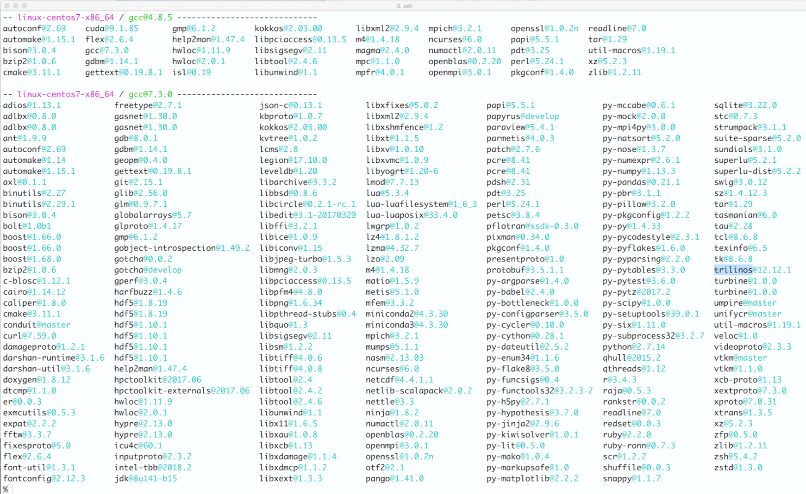
E4S 1.1 Full Release: 50 ECP Packages and all dependencies
Adios
AML
Argobots
Bolt
Caliper
Darshan
Dyninst
Faodel
Flecsi
Gasnet
GEOPM
Gotcha
HDF5
HPCToolkit
Hypre
Kokkos
Legion
Libnrm
Libquo
Magma
Mercury
MFEM
MPICH
MPIFileUtils
Ninja
OpenMPI
PAPI
Papyrus
Parallel netCDF
PDT
PETSc
Qthreads
Raja
Rempi
SCR
Spack
Strumpack
Sundials
SuperLU
SZ
Tasmanian
TAU
Trilinos
Turbine
Packages installed using Spack
Umpire
UnifyFS
UPC++ Veloc
Zfp
All ST products will be released through E4S
Partial (in-progress) Release: ASCENT, Catalyst, Flang, libEnsemble, LLVM, Visit, others

Slide 14
ECP SW Technology Software Architecture – Spack Software Distribution System

Slide 15
Spack enables Software distribution for HPC
Spack automates the build and installation of scientific software
Packages are templated, so that users can easily tune for the host environment
Ease of use of mainstream tools, with flexibility needed for HPC tuning
Major victories:
ARES porting time on a new platform was reduced from 2 weeks to 3 hours
Deployment time for 1,300-package stack on Summit supercomputer reduced from 2 weeks to a 12-hour overnight build
Used by teams across ECP to accelerate development
No installation required: clone and go
$ git clone https://github.com/spack/spack
$ spack install hdf5
Simple syntax enables complex installs
$ spack install hdf5@1.10.5
$ spack install hdf5@1.10.5 %clang@6.0
$ spack install hdf5@1.10.5 +threadssafe
$ spack install hdf5@1.10.5 cppflags="-O3 –g3"
$ spack install hdf5@1.10.5 target=haswell
$ spack install hdf5@1.10.5 +mpi ^mpich@3.2
github.com/spack/spack

Slide 16

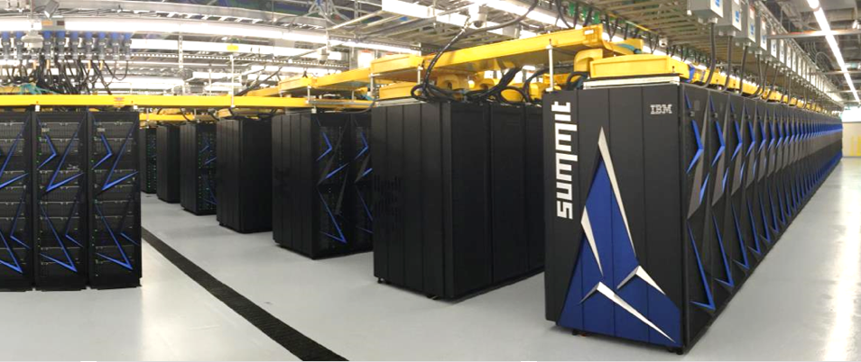
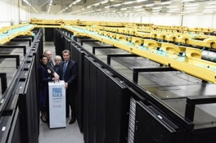
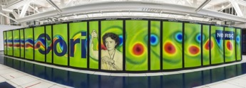
Spack is being used on many of the top HPC systems
Official deployment tool for the U.S. Exascale Computing Project
7 of the top 10 supercomputers
High Energy Physics community
Fermilab, CERN, collaborators
Astra (Sandia)
Fugaku
Fugaku at RIKEN DOE/MEXT collaboration
Summit (ORNL), Sierra (LLNL)
SuperMUC-NG (LRZ, Germany)
Edison, Cori, Perlmutter (NERSC)

Slide 17
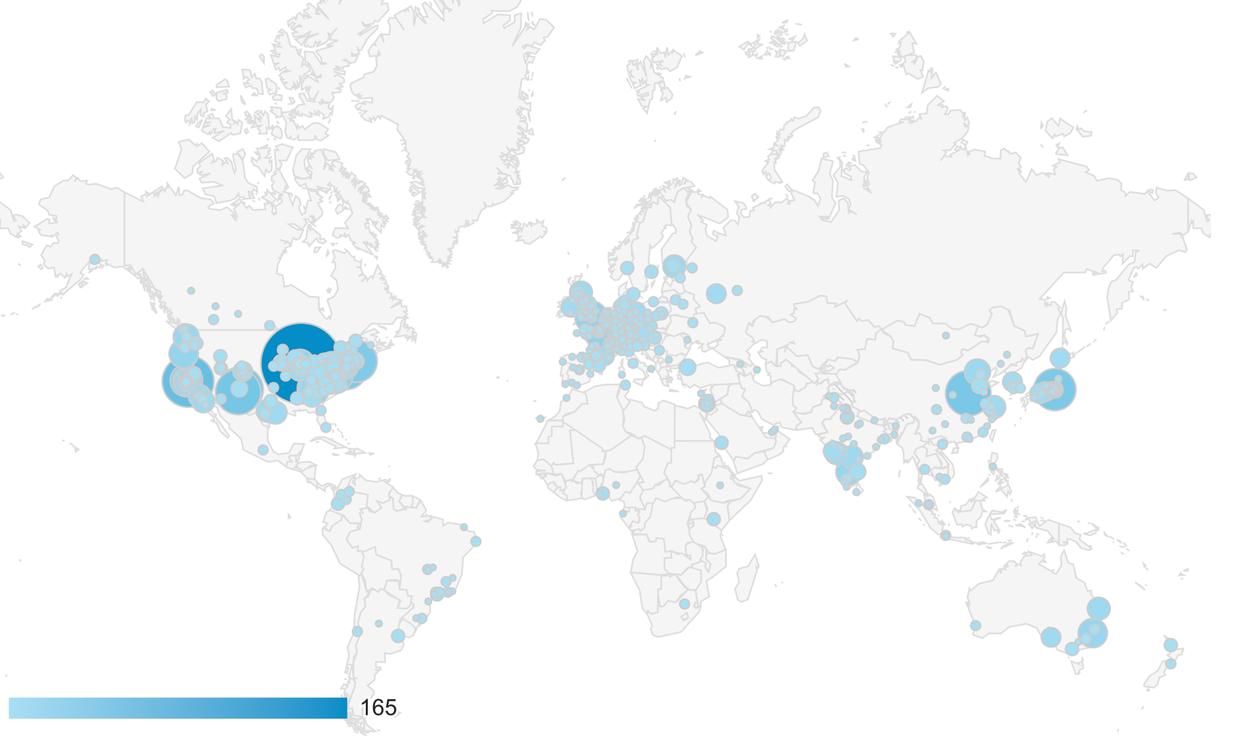
Spack is used worldwide!
Over 3,400 software packages
Over 2,000 monthly active users
Over 400 contributors (and growing)
Active users of Spack documentation site for one month
https://spack.readthedocs.io

Slide 18




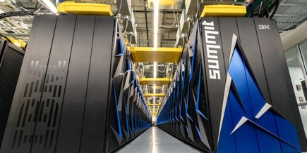

Spack strategy is to enable exascale software distribution on both bare metal and containers
New capabilities to make HPC packaging easy and automated
Optimized builds and package binaries that exploit the hardware
Workflow automation for facilities, developers, and users
Strong integration with containers as well as facility deployments
Develop exascale enhancements to container runtimes
Understand and automate performance/portability tradeoffs
Optimized containers & build automation for exascale HPC centers
Enable portability from laptops to exascale
Outreach to users
Ongoing working groups, Best practice guides
Tutorials, workshops, BOFs for Spack and Containers
Collaboration across ECP
Work with HI and other areas to build service infrastructure
Facilitate curation of packages through E4S and facilities
Ongoing ECP user support
Spack Packaging
Build / Deployment
Automation
Exascale Container Runtimes
Bare Metal Exascale Machines

Slide 19








Spack heavily involved in the ECP CI project.
We have added security features to the open source GitLab product.
Integration with center identity management
Integration with schedulers like SLURM, LSF
We are democratizing testing at Livermore Computing
Users can run tests across 30+ machines by editing a file
Previously, each team had to administer own servers
ECP sites are deploying GitLab CI for users
All HPC centers can leverage these improvements
NNSA labs plan to deploy common high-side CI infrastructure
We are developing new security policies to allow external open source code to be tested safely on key machines
. . .
GitLab test runners are now integrated with HPC machines
User commits to GitLab

Slide 20
ECP SW Technology Software Architecture – SDKs

Slide 21

Software Development Kits (SDKs): Key delivery vehicle for ECP A collection of related software products (packages) where coordination across package teams improves usability and practices, and foster community growth among teams that develop similar and complementary capabilities
Domain scope Collection makes functional sense
Interaction model How packages interact; compatible, complementary, interoperable
Community policies Value statements; serve as criteria for membership
Meta-infrastructure Invokes build of all packages (Spack), shared test suites
Coordinated plans Inter-package planning. Augments autonomous package planning
Community outreach Coordinated, combined tutorials, documentation, best practices
ECP ST SDKs: Grouping similar products for collaboration & usability
Programming Models & Runtimes Core
Tools & Technologies
Compilers & Support
Math Libraries (xSDK)
Viz Analysis and Reduction
Data mgmt., I/O Services & Checkpoint/ Restart
“Unity in essentials, otherwise diversity”

Slide 22

xSDK community policies
https://xsdk.info/policies
xSDK compatible package: Must satisfy mandatory xSDK policies:
M1. Support xSDK community GNU Autoconf or CMake options.
M2. Provide a comprehensive test suite.
M3. Employ user-provided MPI communicator.
M4. Give best effort at portability to key architectures.
M5. Provide a documented, reliable way to contact the development team.
M6. Respect system resources and settings made by other previously called packages.
M7. Come with an open source license.
M8. Provide a runtime API to return the current version number of the software.
M9. Use a limited and well-defined symbol, macro, library, and include file name space.
M10. Provide an accessible repository (not necessarily publicly available).
M11. Have no hardwired print or IO statements.
M12. Allow installing, building, and linking against an outside copy of external software.
M13. Install headers and libraries under <prefix>/include/ and <prefix>/lib/.
M14. Be buildable using 64 bit pointers. 32 bit is optional.
M15. All xSDK compatibility changes should be sustainable.
M16. The package must support production-quality installation compatible with the xSDK install tool and xSDK metapackage.
Also recommended policies, which currently are encouraged but not required:
R1. Have a public repository.
R2. Possible to run test suite under valgrind in order to test for memory corruption issues.
R3. Adopt and document consistent system for error conditions/exceptions.
R4. Free all system resources it has acquired as soon as they are no longer needed.
R5. Provide a mechanism to export ordered list of library dependencies.
R6. Provide versions of dependencies.
xSDK member package: Must be an xSDK-compatible package, and it uses or can be used by another package in the xSDK, and the connecting interface is regularly tested for regressions.
We welcome feedback. What policies make sense for your software?

Slide 23

xSDK version 0.4.0: December 2018
https://xsdk.info
Multiphysics Application C
Each xSDK member package uses or can be used with one or more xSDK packages, and the connecting interface is regularly tested for regressions.
Tested on key machines at ALCF, NERSC, OLCF, also Linux, Mac OS X
Application A
Application B
Alquimia
SLEPc
hypre
AMReX
Omega_h
HDF5
deal.II
SUNDIALS
PUMI
PFLOTRAN
PETSc
PHIST
BLAS
SuperLU
Trilinos
MFEM
MAGMA
More libraries
More domain components
More external software
STRUMPACK
DTK
Tasmanian
PLASMA
December 2018
17 math libraries
2 domain components
16 mandatory xSDK community policies
Spack xSDK installer
Impact: Improved code quality, usability, access, sustainability
Foundation for work on performance portability, deeper levels of package interoperability
Domain components
Reacting flow, etc.
Reusable.
Libraries
Solvers, etc.
Interoperable.
Frameworks & tools
Doc generators.
Test, build framework.
SW engineering
Productivity tools.
Models, processes.
Extreme-Scale Scientific Software Development Kit (xSDK)

Slide 25
xSDK version 0.5: November 2019 (21 math libs, 2 domain-specific packages)
AMReX
ButterflyPACK
DTK
deal.ii
Ginkgo
hypre
libEnsemble
MAGMA
MFEM
Omega_h
PETSc/TAO
PHIST
PLASMA
preCICE
PUMI
SLEPc
STRUMPACK
SUNDIALS
SuperLU
Tasmanian
Trilinos
Pflotran
Alquimia
Notes:
Growth:
5 in release 0.1.
7 in 0.2
9 in 0.3
19 in 0.4
23 in 0.5
You do not need to build all packages.
We build and test all packages.
Any subset is guaranteed to build if using the same build parameters, platforms.
Similar builds should work or require less effort for success.

Slide 26
SDK “Horizontal” Grouping: Key Quality Improvement Driver
PETSc
Trilinos
SuperLU Version X
SuperLU Version Y
Horizonal (vs Vertical) Coupling
Common substrate
Similar function and purpose
e.g., compiler frameworks, math libraries
Potential benefit from common Community Policies
Best practices in software design and development and customer support
Used together, but not in the long vertical dependency chain sense
Support for (and design of) common interfaces
Commonly an aspiration, not yet reality
Horizontal grouping:
Assures X=Y.
Protects against regressions.
Transforms code coupling from heroic effort to turnkey.

Slide 27
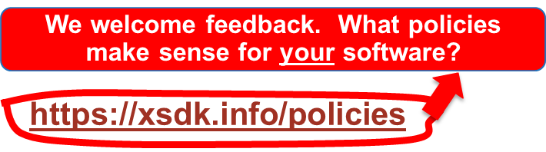
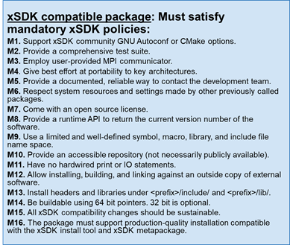
Development of xSDK Community Policies
Community policies now available on Github for revision control and to preserve history: https://github.com/xsdk-project/xsdk-community-policies
Established process on how to change or add policies
Newest release: 0.5.0
Also recommended policies, which currently are encouraged but not required:
R1. Have a public repository.
R2. Possible to run test suite under valgrind in order to test for memory corruption issues.
R3. Adopt and document consistent system for error conditions/exceptions.
R4. Free all system resources it has acquired as soon as they are no longer needed.
R5. Provide a mechanism to export ordered list of library dependencies.
R6. Provide versions of dependencies.
R7. Have README, SUPPORT, LICENSE, and CHANGELOG file in top directory.
Changes in 0.5.0:
New recommended policy R7
Dropped the requirement to detect MPI 2 features in M3
Made various editorial changes in M5, M13, M15, and R2 for clarification or to fix typos.

Slide 28
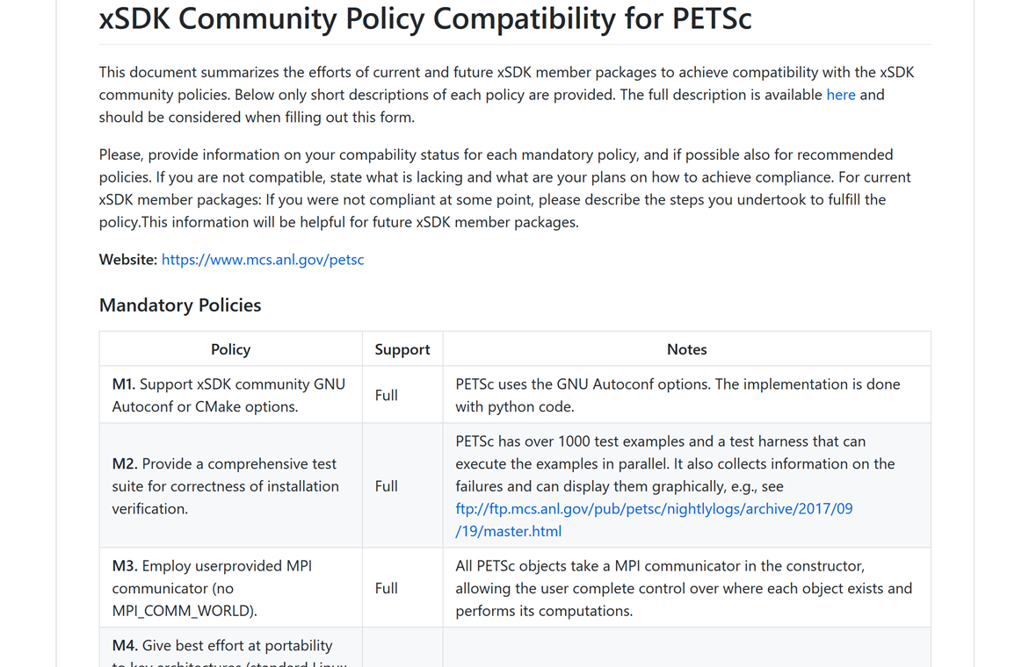
Integration of Community Policies
Potential new xSDK members will fill out compatibility form: https://github.com/xsdk-project/xsdk-policy-compatibility
xSDK team will check for compatibility and approve if compatible
Designing and implementing xSDK policy checker to automate the policy compliance checking.
Implemented checkers for a few policy rules. Examples:
M3: Employ user-provided MPI Communicator: Policy checker lists the file names that contain MPI_COMM_WORLD.
M7: Come with an open source license. Policy checker search license files at the top directly of the source and scan the headers of source code files.

Slide 29
Processes for xSDK release and delivery
2-level release process
xSDK
Ensure and test compatibility of mostly independent package releases
xSDK member packages
Achieve compatibility with xSDK community policies prior to release
https://github.com/xsdk-project/xsdk-policy-compatibility
Have a Spack package
Port to target platforms
Provide user support
Obtaining the latest release: https://xsdk.info/releases
Draft xSDK package release process checklist:
https://docs.google.com/document/d/16y2bL1RZg8wke0vY8c97ssvhRYNez34Q4QGg4LolEUk/edit?usp=sharing
xSDK delivery process
Regular releases of software and documentation, primarily through member package release processes
Anytime open access to production software from GitHub, BitBucket and related community platforms

Slide 30
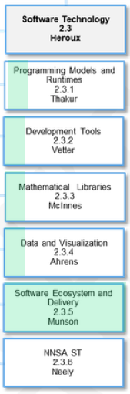
There are 5 L4 projects to define and/or enhance SDKs
WBS Areas
Each L3 area has an L4 project devoted to SDK definition and coordination across the portfolio
Software ecosystem L4 project focuses on packaging
Spack
Containers
Strong coordination with HI Software Deployment projects
Drives milestone-based planning

Slide 31
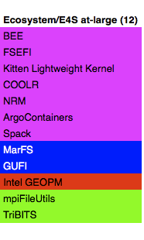
ECP ST SDKs will span all technology areas
Motivation: Properly chosen cross-team interactions will build relationships that support interoperability, usability, sustainability, quality, and productivity within ECP ST.
Action Plan: Identify product groupings where coordination across development teams will improve usability and practices, and foster community growth among teams that develop similar and complementary capabilities.
PMR Core (17)
Compilers and Support (7)
Tools and Technology (11)
xSDK (16)
Visualization Analysis and Reduction (9)
Ecosystem/E4S at-large (12)
Data mgmt, I/O Services, Checkpoint restart (12)
QUO
openarc
TAU
hypre
ParaView
SCR
mpiFileUtils
Papyrus
Kitsune
HPCToolkit
FleSCI
Catalyst
FAODEL
TriBITS
SICM
LLVM
Dyninst Binary Tools
MFEM
VTK-m
ROMIO
MarFS
Legion
CHiLL autotuning comp
Gotcha
Kokkoskernels
SZ
Mercury (Mochi suite)
GUFI
Kokkos (support)
LLVM openMP comp
Caliper
Trilinos
zfp
HDF5
Intel GEOPM
RAJA
OpenMP V & V
PAPI
SUNDIALS
VisIt
Parallel netCDF
BEE
CHAI
Flang/LLVM Fortran comp
Program Database Toolkit
PETSc/TAO
ASCENT
ADIOS
FSEFI
PaRSEC*
Search (random forests)
libEnsemble
Cinema
Darshan
Kitten Lightweight Kernel
DARMA
Siboka
STRUMPACK
ROVER
UnifyCR
COOLR
GASNet-EX
C2C
SuperLU
VeloC
NRM
Qthreads
Sonar
ForTrilinos
IOSS
ArgoContainers
BOLT
SLATE
HXHIM
Spack
UPC++
MAGMA
PMR
MPICH
DTK
Tools
Legend
Open MPI
Tasmanian
Math Libraries
Umpire
TuckerMPI
Data and Vis
AML
Ecosystems and delivery

Slide 32
Data SDK: HDF5 API Initiative
Adding The HDF Group (THG) to the Data & Vis SDK project to assist in various aspects of improving the use of the HDF5 API
Support and training
Direct support and training will be provided to ECP applications and ST projects to assist in the performant use of HDF5
Compatible APIs with other I/O libraries
DataLib (pnetcdf) and ADIOS will develop interfaces compatible with the HDF5 API, possibly through the HDF5 Virtual Object Layer
THG will provide support to the I/O projects to assist in achieving this compatibility
Both Kitware and THG will identify the I/O usage patterns w.r.t. metadata operations, bulk data operations, access patterns.
This will help identify usage patterns that can be improved on by applications and ST projects
Also will help identify usage patterns that HDF5 can work to optimize for.

Slide 33
SDK Summary
SDKs will help reduce complexity of delivery:
Hierarchical build targets.
Distribution of software integration responsibilities.
New Effort: Started in April 2018, fully established in August 2018.
Extending the SDK approach to all ECP ST domains.
SDKs create a horizontal coupling of software products, teams.
Create opportunities for better, faster, cheaper – pick all three.
First concrete effort: Spack target to build all packages in an SDK.
Decide on good groupings.
Not necessarily trivial: Version compatibility issues, Coordination of common dependencies.
Longer term:
Establish community policies, enhance best practices sharing.
Provide a mechanism for shared infrastructure, testing, training, etc.
Enable community expansion beyond ECP.

Slide 34
Putting it all together: Products + SDKs + E4S
Build
Deliver
Test
Integrate
In ECP, teams increasingly need to ensure that their libraries and components work together
Historically, HPC codes used very few dependencies
Now, groups of teams work together on small releases of “Software Development Kits”
SDKs will be rolled into a larger, periodic release.
E4S
ECP-wide software release
https://e4s.io
Develop
Deliver
Test
Build
Package
Develop
Build
Deliver
Test
Package
Develop
Build
Deliver
Test
Package
Math Libraries
Visualization
Programming
Models
…

Slide 35
E4S Collaborations

Slide 36
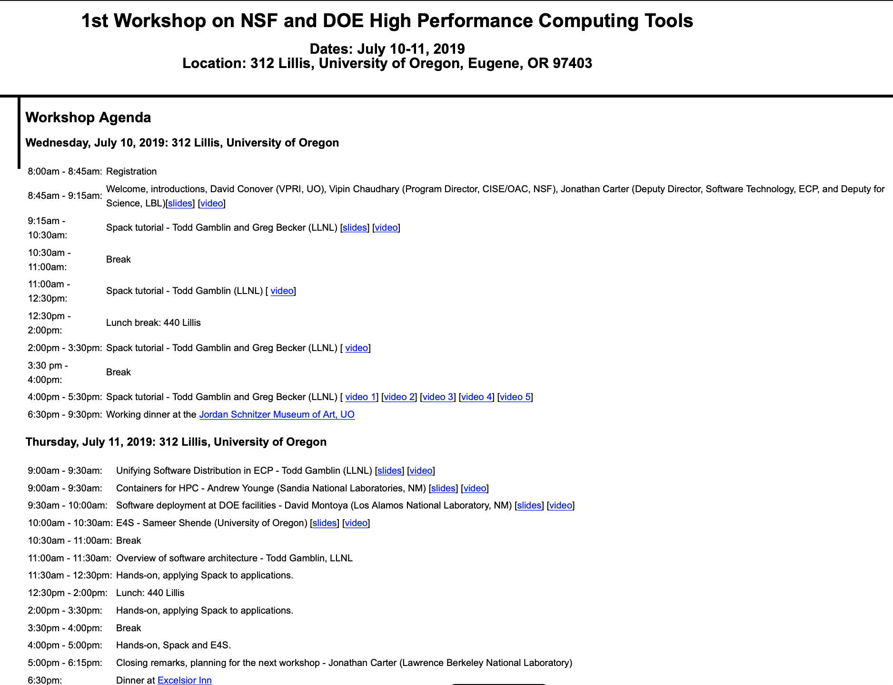
NSF Collaborations
https://oaciss.uoregon.edu/NSFDOE19/agenda.html

Slide 37
Extending Collaborations
E4S/SDK collaborations make sense with:
HPC open source development projects:
deal.II (NSF math library),
PHIST (DLR Germany library).
Commercial open source packagers/distributors:
OpenHPC.
HPC systems vendors.
HPC systems facilities:
SDSC, TACC, others.
Other organizations in search of collaborative open source software foundation:
NSF science teams.
NOAA, others.
International collaborators.

Slide 38
E4S: Building on top of previous efforts
E4S did not emerge from nothing.
Leveraging the work of many others.
HPC Linux: Work done at U of Oregon, and at ParaTools.
IDEAS-Classic: xSDK – the original SDK continuing under ECP.
Spack – Pre-dates E4S.

Slide 39
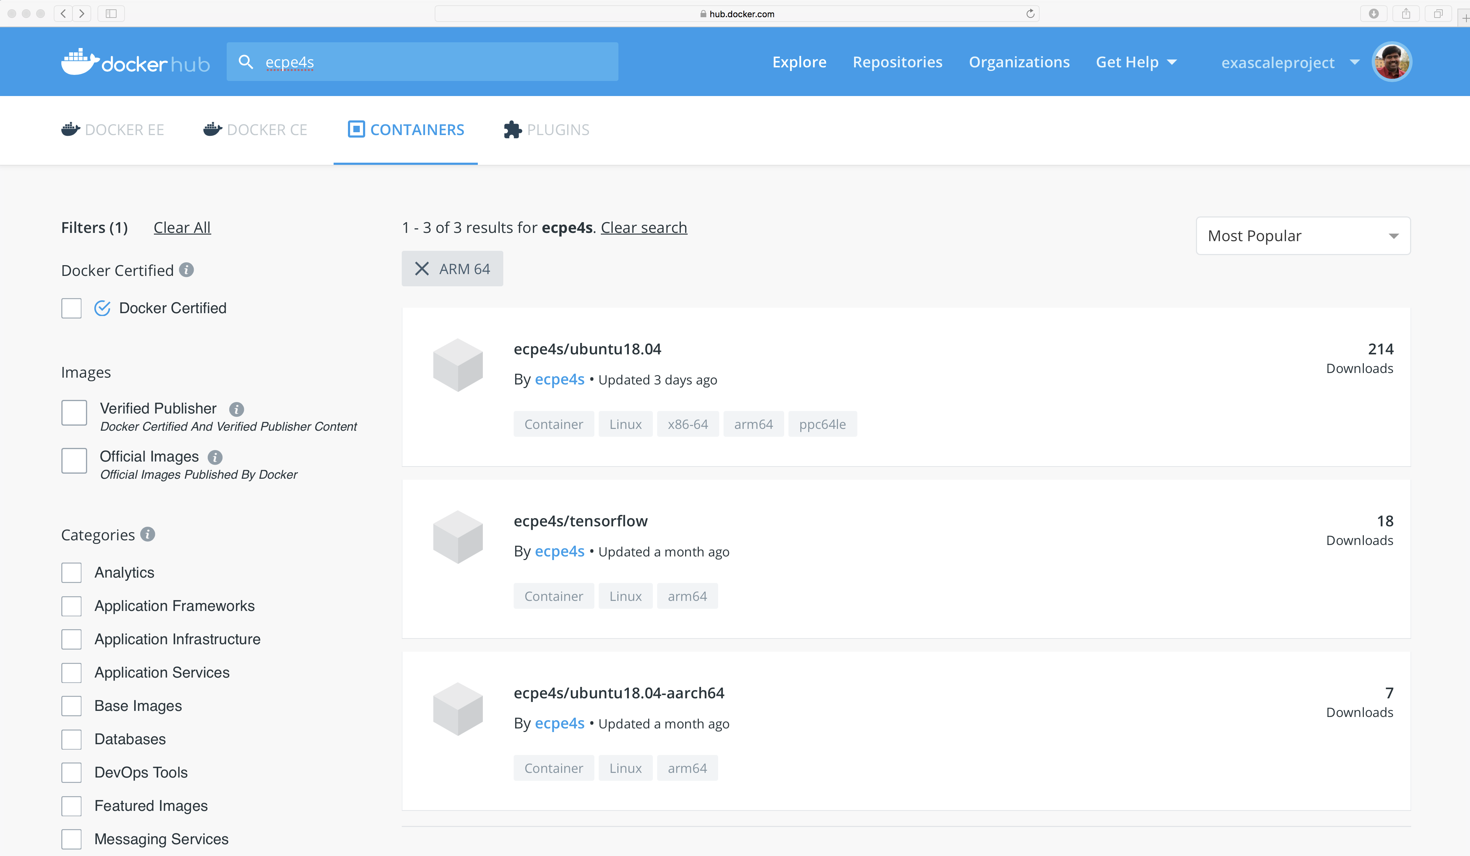
E4S: ARM64 Base Container Images
Dockerhub
Support for NVDIA GPUs
Notes:
quick run through - what ECP ST is working on

Slide 40
E4S Wrap Up

Slide 41
Delivering an open, hierarchical software ecosystem
Levels of Integration Product Source and Delivery
ECP ST Individual Products
ST Products
Source: ECP L4 teams; Non-ECP Developers; Standards Groups
Delivery: Apps directly; spack; vendor stack; facility stack
SDKs
Source: ECP SDK teams; Non-ECP Products (policy compliant, spackified)
E4S
Source: ECP E4S team; Non-ECP Products (all dependencies)
Delivery: spack install e4s; containers; CI Testing
Delivery: Apps directly; spack install sdk; future: vendor/facility
ECP Legacy: An open, hierarchical and extensible HPC software ecosystem
SDK communities for enhanced developer and user experience
Easy deployment via source and by container technologies
In collaboration with DOE facilities, vendors, other US agencies and strategic collaborators
A model for post-ECP coordinated software development and delivery.
Standard workflow
Existed before ECP
Group similar products
Make interoperable
Assure policy compliant
Include external products
Build all SDKs
Build complete stack
Containerize binaries
ECP ST Open Product Integration Architecture

Slide 42
E4S Summary
What E4S is not
What E4S is
A closed system taking contributions only from DOE software development teams.
A monolithic, take-it-or-leave-it software behemoth.
A commercial product.
A simple packaging of existing software.
Extensible, open architecture software ecosystem accepting contributions from US and international teams.
Framework for collaborative open-source product integration.
A full collection if compatible software capabilities and
A manifest of a la carte selectable software capabilities.
Vehicle for delivering high-quality reusable software products in collaboration with others.
The conduit for future leading edge HPC software targeting scalable next-generation computing platforms.
A hierarchical software framework to enhance (via SDKs) software interoperability and quality expectations.

Slide 43
Final Remarks
Software Development Kits (SDKs) provide a new software coordination mechanism:
Do not significantly increase the number of software products in the HPC ecosystem.
Provide intermediate build, install and test targets for E4S (reducing complexity).
Enable development teams to improve and standardize look-and-feel, best practices, policies.
Improve interoperability, interchangeability of similar products.
Fosters communities of developers in a cooperative/competitive environment.
Provides integration point for SDK-compatible, non-ECP products.
The Extreme-scale Scientific Software Stack (E4S) provides a complete HPC software stack:
Does not significantly increase the number of software products in the HPC ecosystem.
Provides a coordinated approach to building, installing and testing HPC software.
Tests some products with a subset of configurations on a subset of platforms.
Improves stability of the ST stack so that any subset is more stable.
Provides a complete software stack, including non-ECP products.
The SDK/E4S architecture is open:
Enables light-weight coordinated collaboration among open source software teams.
ECP seeks collaboration: libraries/tools and SDKs, facilities and E4S.

Slide 44
ECP Software Technology Capability Assessment Report (CAR) Version 2.0
Comprehensive document about ECP ST structure, progress and planning.
Version 2.0 – extensive revision:
FY20 – 23 Organization.
Planning, Execution, Tracking & Assessment processes.
E4S/SDK details.
2-page writeups for each product development effort.
Released February 1, 2020.
https://exascaleproject.org/wp-content/uploads/2020/02/ECP-ST-CAR-V20-1.pdf

